Slide 1
KEY:
(12) Tarps
(8) Banana Boxes
(3) Home Depot buckets + (6) Chamois
(14) Art Boxes
HD
+ (2) chamois
Portable Projector Screen
+ (2) chamois
Tarps
Students will take
shoes off
and sit here for
Pollock Intro
and then return here after
project to clean up.
HD
4’x8’ Class Pollock
HD
Podium
(Epson)
Heat Register
Station #1
WINDOWS
Doors to Cafeteria B
Station #2
Station #3
Start
Place
tarps
Cafeteria B Lunch Line
HD
+(2) chamois
Pour
Paint
only 2”
Make
(14)
Art Boxes
Park Elementary
Kindergarten Art Ambassador
VOLUNTEERS
Cafeteria B Room Layout & Set-Up Pyramid
Place
Banana
Boxes
Put
Water in
Home Depot
Buckets
Place
Tinted
Glues
Place
Station
TOOLS
Class
4’x8’
Foam Board
Station #1
Artists
Canvas
Boards
Station #2
White
Office
Folders
Station #3

Slide 2
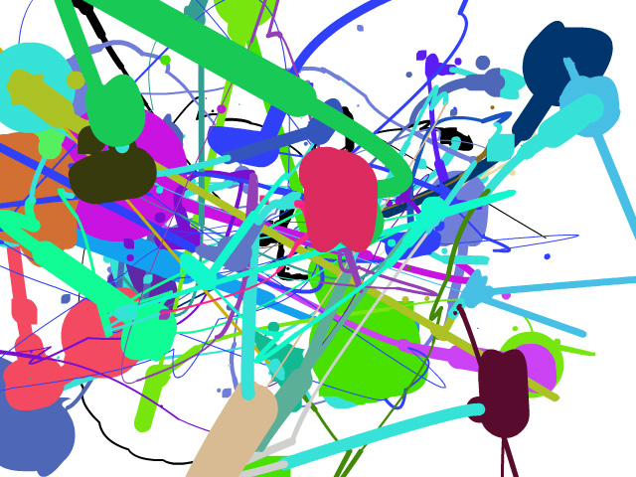
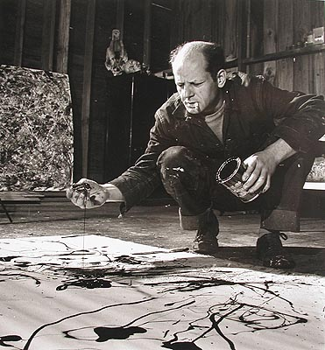
Jackson Pollock
Action Painting
Abstract Expressionism
BY: Teri ALLART

Slide 3
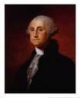
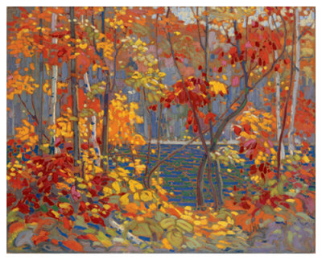
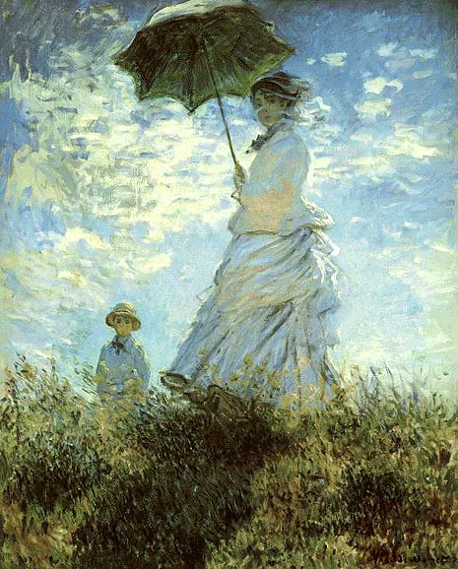
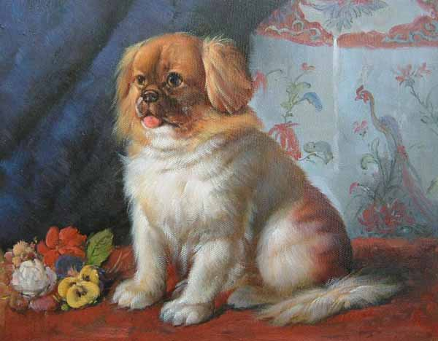
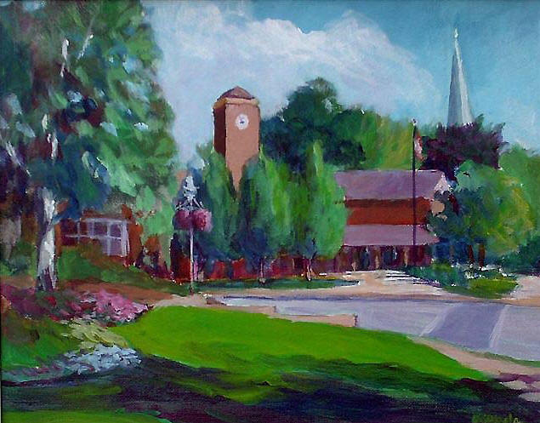
Most paintings we see have…
people, buildings, animals or other objects we recognize in them.

Slide 4
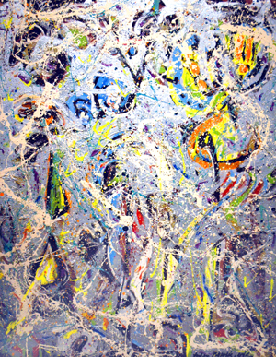
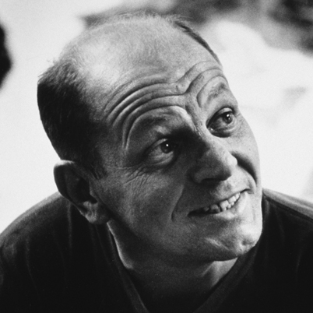
We’re going to learn about an American artist named…
Jackson Pollock
whose paintings looked more like this when he was done.
Galaxy, 1947
This style is called…
“Abstract Expressionism” because you can’t see anything or anyone clearly.

Slide 5
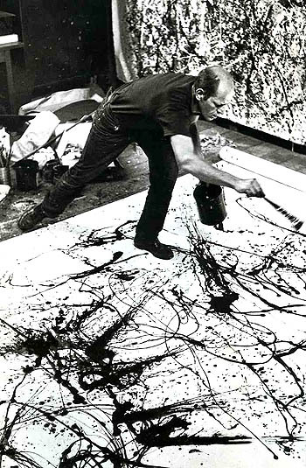
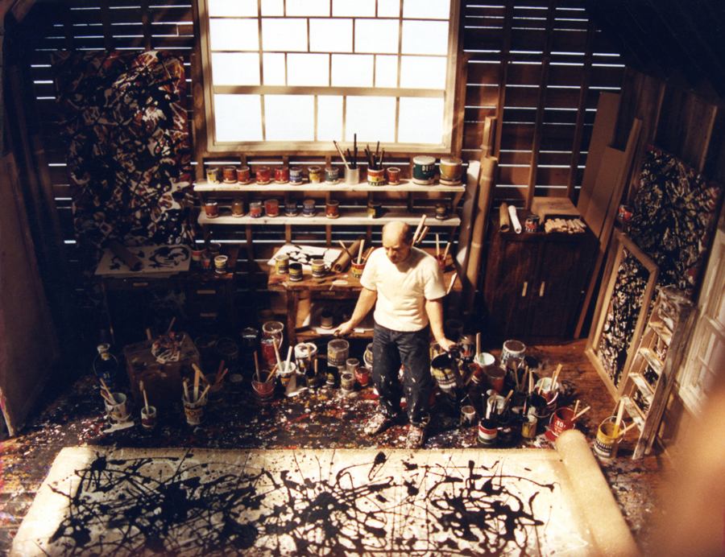
Jackson POLLOCk’s STYLE
He was nicknamed “Action Jackson” because of the active way he moved around his art while painting.
He splattered, dripped and poured paint all over his canvas that was spread out on the floor of his barn! He used sticks, old hardened brushes, sand, and string to build up layers of color.

Slide 6
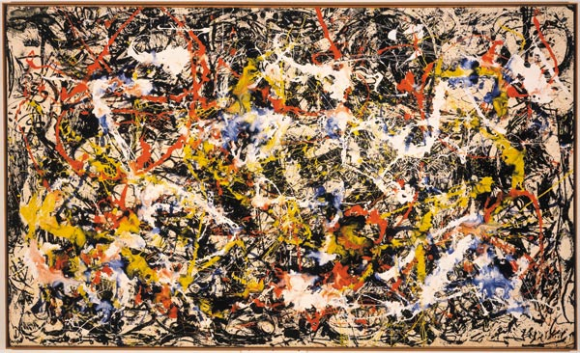
Convergence, 1952
You can’t recognize any objects in Pollock’s paintings like a person, tree or animal.

Slide 7
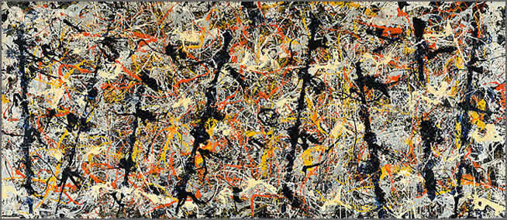
Blue Poles, 1952
Jackson painted how he felt inside, not what he saw around him.
He wanted people to see and feel the energy he felt while he was painting.

Slide 8
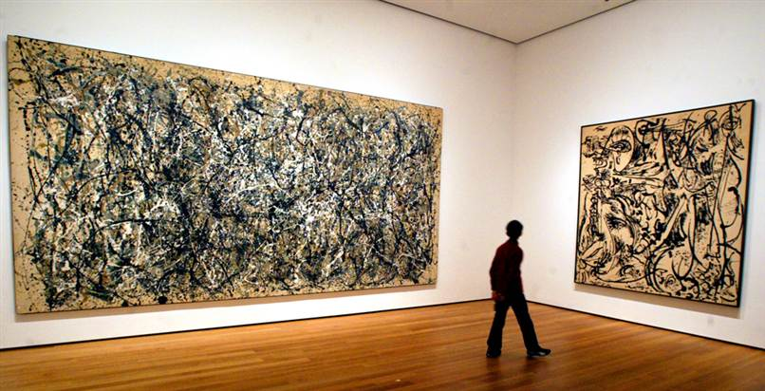
Autumn Rhythm, 1950
Echo: Number 25, 1951
Jackson Pollock’s paintings are filled with a lot of movement and energy.
They are bigger than a king size bed!

Slide 9
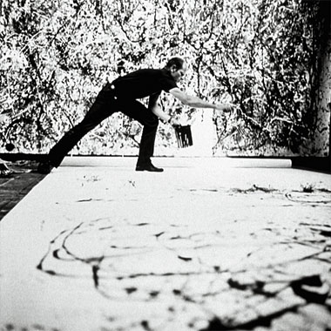
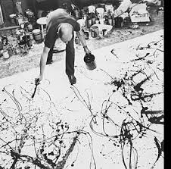
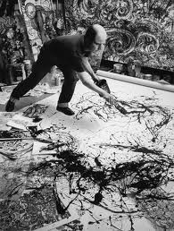
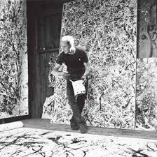
Art AMBASSADOR Project:
To create “Action Paintings” when you let your feelings come out and paint like
JACKSON POLLOCK !
ONLY ONE RULE:
NEVER touch your paper with any of your art tools!
We will get into (3) groups (approximately 7 students); one group to each station

